Slide 1

Sustainable Development
By: Reham Hussein Ramadan
Track: Open Source Application Development

Slide 2
Year
1939

Slide 3
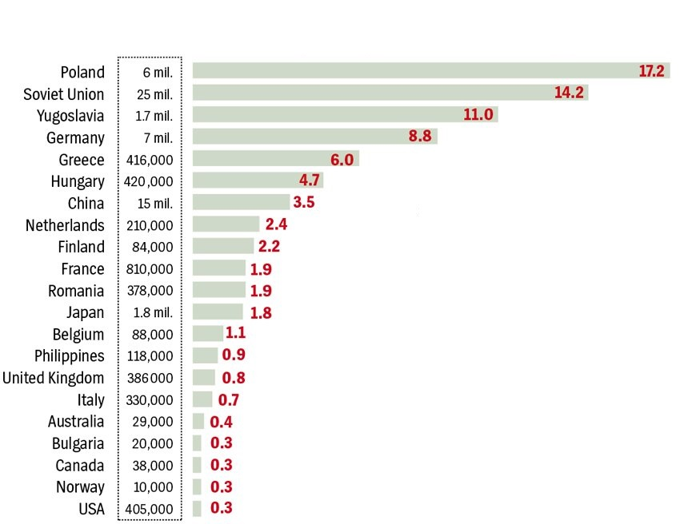
Second World War
1939 to 1945.
Estimated total of 70-85 million people perished.

Slide 4
UNISCO ?

Slide 5

UNISCO
Contribute to peace and security by promoting collaboration among nations through education, science and culture in order to further universal respect for justice, for the rule of law and for the human rights and fundamental freedoms which are affirmed for the peoples of the world, without distinction of race, sex, language or religion, by the Charter of the United Nations.

Slide 6
UNISCO
signed on 16 November 1945.
came into force on 4 November 1946 after ratification by twenty countries: Australia, Brazil, Canada, China, Czechoslovakia, Denmark, Dominican Republic, Egypt, France, Greece, India, Lebanon, Mexico, New Zealand, Norway, Saudi Arabia, South Africa, Turkey, United Kingdom, United States.
located in Paris, France, Website http://www.unesco.org

Slide 7
Sustainable
development?

Slide 8

Sustainable Development
Sustainable development is development that meets the needs of the present, without compromising the ability of future generations to meet their own needs.

Slide 9

Sustainable Development Goals

Slide 10
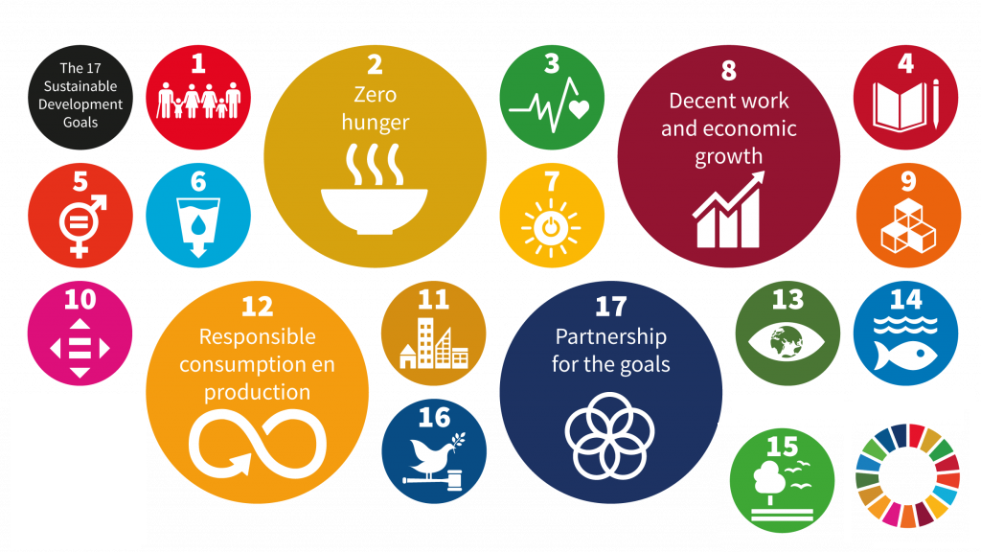

Slide 11
Sustainable
Development in Egypt ?

Slide 12

Sustainable Development in Egypt
Inspired by the ancient Egyptian Civilization, linking the present to future, the Sustainable Development Strategy (SDS): Egypt Vision 2030 represents a foothold on the way towards inclusive development. Thus cultivating a prosperity path through, economic and social justice, and reviving the role of Egypt in regional leadership. SDS represents a roadmap for maximizing competitive advantage to achieve the dreams and aspirations of Egyptians in a dignified and decent life

Slide 13
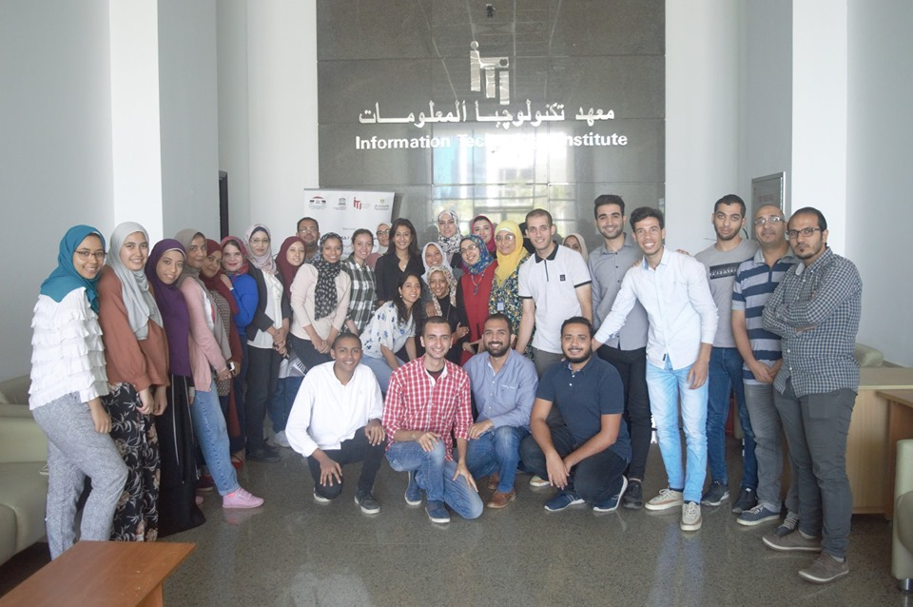
Training Course on the Application of Opensource Software
Project: the Future of Open Source Software and its Role in Reinforcing the Information Society in Developing countries for Sustainable Development.

Slide 14
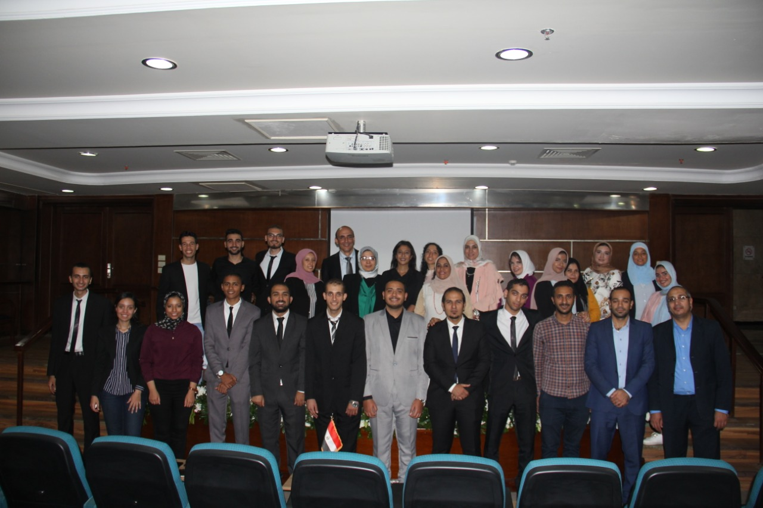
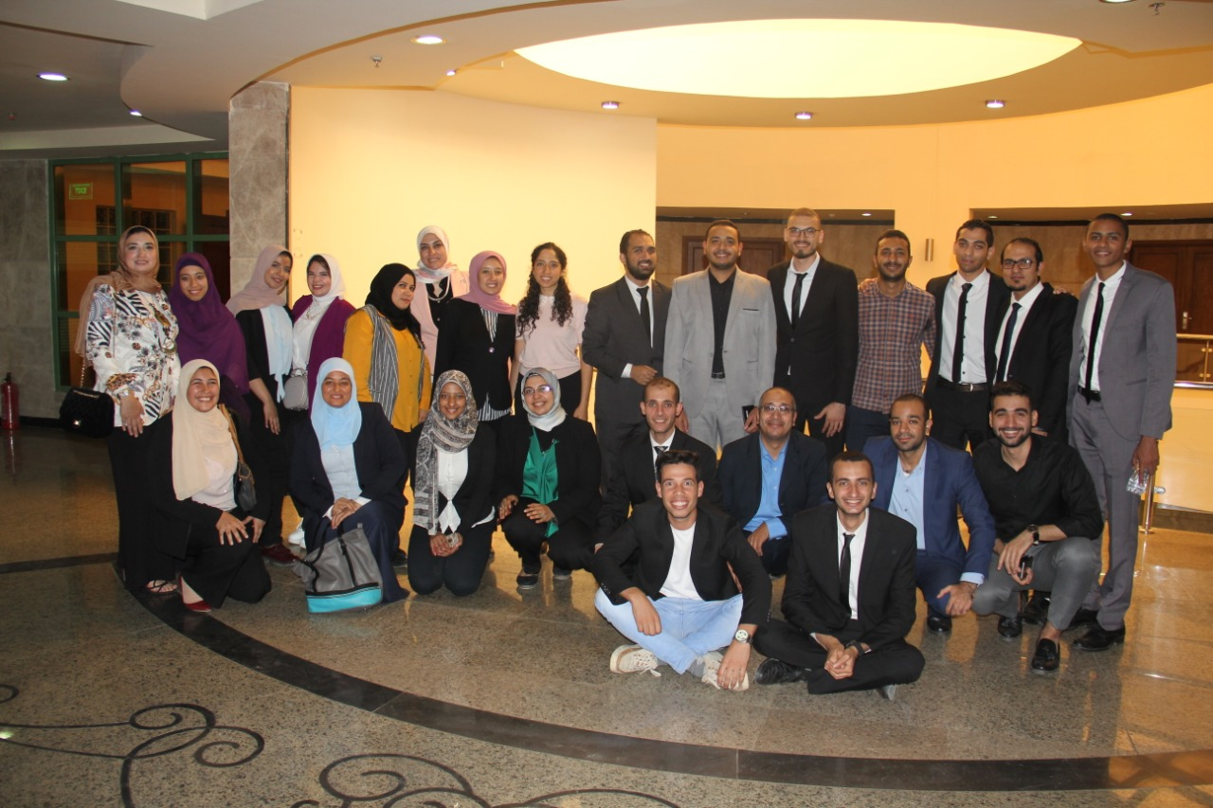

Training Course on the Application of Opensource Software(cont..)

Slide 15
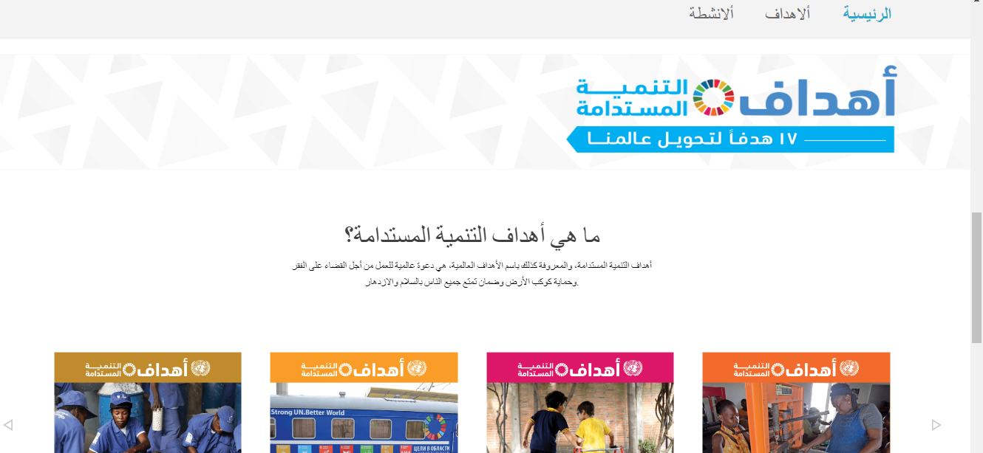
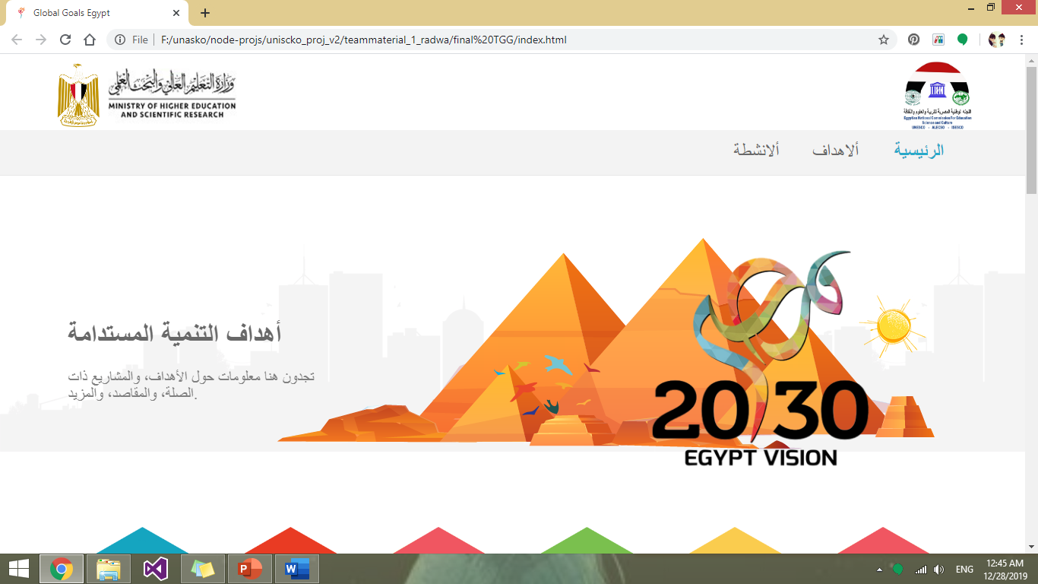
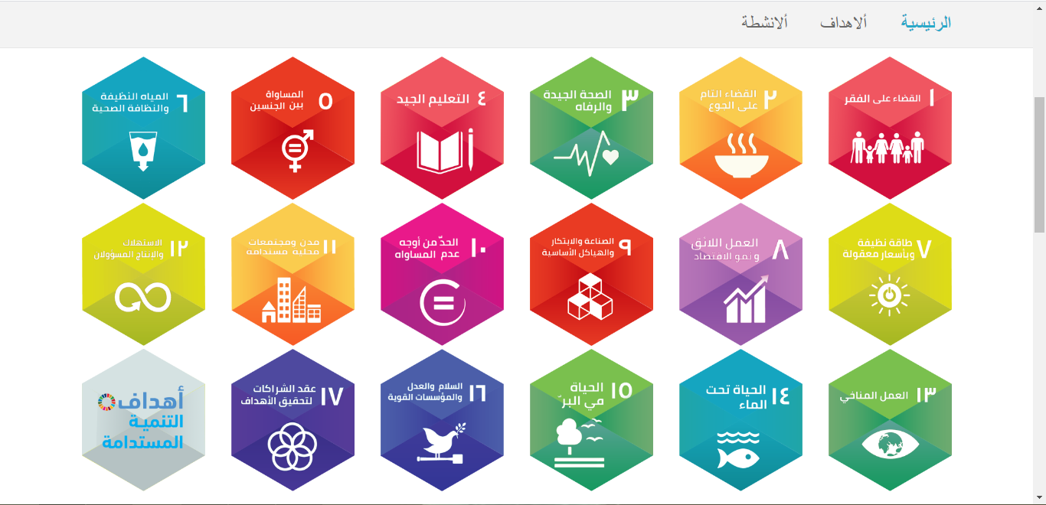



Slide 16
Recap
Second World War.
UNISCO.
Sustainable Development.
Sustainable Development Goals.
Sustainable Development in Egypt.
Training Course on the Application of Opensource Software.

Slide 17
References
World War Ii Casualties, https://en.wikipedia.org/wiki/World_War_II_casualties.
What Is Unesco?, https://www.mext.go.jp/en/unesco/title03/detail03/1373238.htm.
What Is Sustainable Development, http://www.sd-commission.org.uk/pages/what-is-sustainable-development.html
Egypt's Vision 2030, http://www.cabinet.gov.eg/English/GovernmentStrategy/Pages/Egypt%E2%80%99sVision2030.aspx
Notes:
https://en.wikipedia.org/wiki/World_War_II_casualties
https://www.mext.go.jp/en/unesco/title03/detail03/1373238.htm
http://www.sd-commission.org.uk/pages/what-is-sustainable-development.html
http://www.cabinet.gov.eg/English/GovernmentStrategy/Pages/Egypt%E2%80%99sVision2030.aspx

Slide 18


